Slide 1
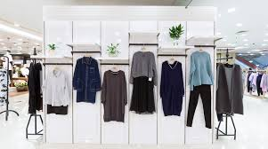
Fashion recommendation system by deep learning
Capstone project - ii
Presented By
Aman Singh

Slide 2
Contents:
Introduction
Deep Learning Technique
Pipeline
Get Data & Data Understanding
Exploratory Data Analysis
K-Nearest Neighbor
Conclusion
Deployment
RESNET50

Slide 3
introduction
Recommendation system is referred to as a decision-making approach for users under a multidimensional information environment. It has also been defined as an e-commerce tool, which helps consumers search based on the knowledge that is related to a consumer’s choices and preferences.
Recommendation System are of three types:
1. Collaborative Filtering
2. Content Based Filtering
3. Hybrid Recommendations
On e-commerce platforms, where numerous choices are available, an efficient recommendation system is required to sort, order, and efficiently convey relevant product content or information to users.
A fashion recommendation system is an application that recommends the most trending fashion based on the user’s search query.
For example, if a user is looking for a high ankle shoes, the recommendation system will recommend the most trending or highly rated high ankle shoes on their platform.

Slide 4
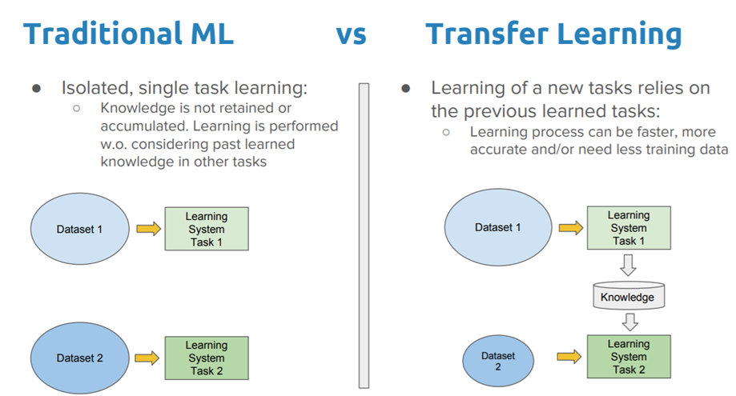
Deep Learning Technique
In this project, we have used ‘Transfer Learning’ technique.
Transfer Learning: It is a Machine learning Technique, which reuses a pre-trained model on a new problem.
Benefits of using Transfer Learning:
1. Speed up the training process
2. Gives better performance
3. No need of large dataset

Slide 5
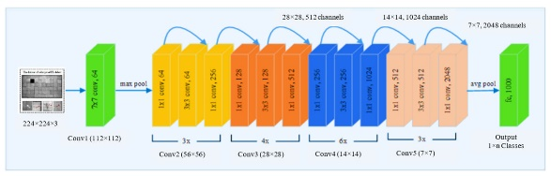
RESNET50
The ResNet50 is a deep convolutional neural network that was introduced by Microsoft Research in 2015.
It is a powerful model that has been trained on millions of images and can recognize a wide range of objects, including fashion items.
It consists of 50 layers and achieved ‘State-Of-The-Art’ performance on the ImageNet dataset in 2015.
This makes it an ideal choice for building a fashion recommendation system.

Slide 6
Pipeline
Data Acquisition
Extract Features
Load Extracted Features
Import Model
Save Images
Generate Recommendations

Slide 7
Get Data & Data Understanding
The dataset is obtained from Kaggle.
In this dataset, we have 44, 441 images and their description is available in the csv file.
Features in the dataset:
1. Gender: Men/Women/Unisex/Boys/Girls
2. Category: There are 7 unique categories in the dataset.
3. Sub-Category: There are 45 unique sub-categories in the dataset.
4. Type: There are 145 type of items in the dataset
5. Color: Represents the color of the item.
6. Season: Summer/Winter/Spring/Fall(Autumn)
7. Year: Represents the manufacturing year of the item.
8. Product Display Name: Represents the display name of the item.

Slide 8
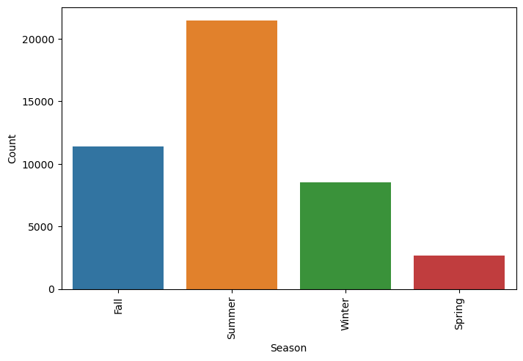
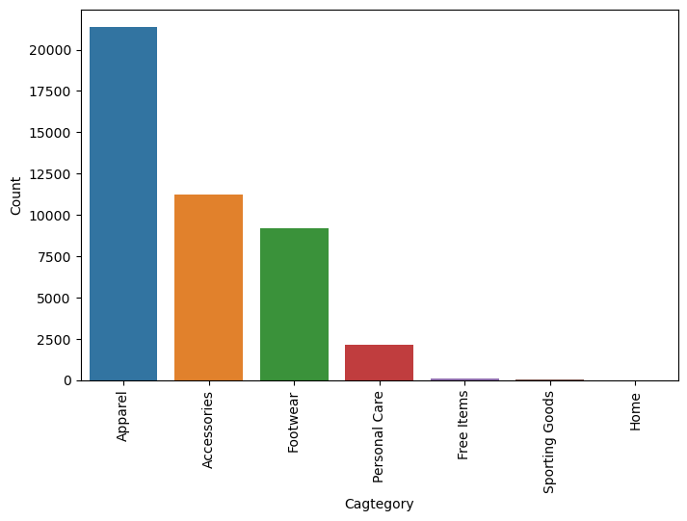
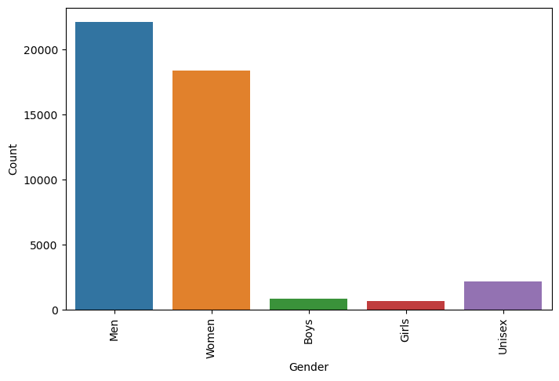
Exploratory Data Analysis
Analysis:
Most of the items are related to the men in our dataset.
Most of the items are related to 'Apparel' category.
We have most of the collection for 'Summer' in the dataset.

Slide 9
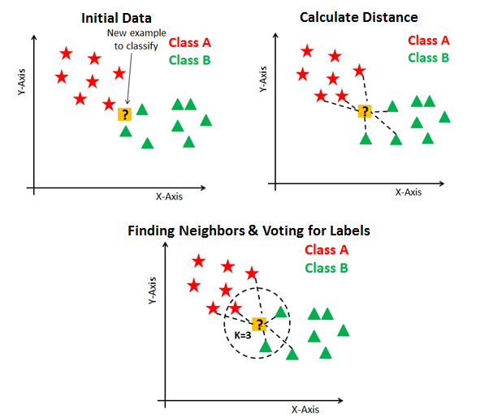
K-nearest neighbors
The K-Nearest Neighbor algorithm is used to detect the nearest neighbor or a cluster based on the k value.
K-Nearest Neighbor is also known as lazy learner.
It is because K- Nearest Neighbor does not require training of the data.
The KNN algorithm is implemented on the vectors to detect the next nearest vectors.
We have used Euclidean distance function to find the distance between vectors.
This distance function predicts the values easily and the top similar products are displayed to the user.

Slide 10
Conclusion
By performing Transfer Learning and K-Nearest Neighbor, we are able to predict and recommend similar content based on the search history of the customer

Slide 11
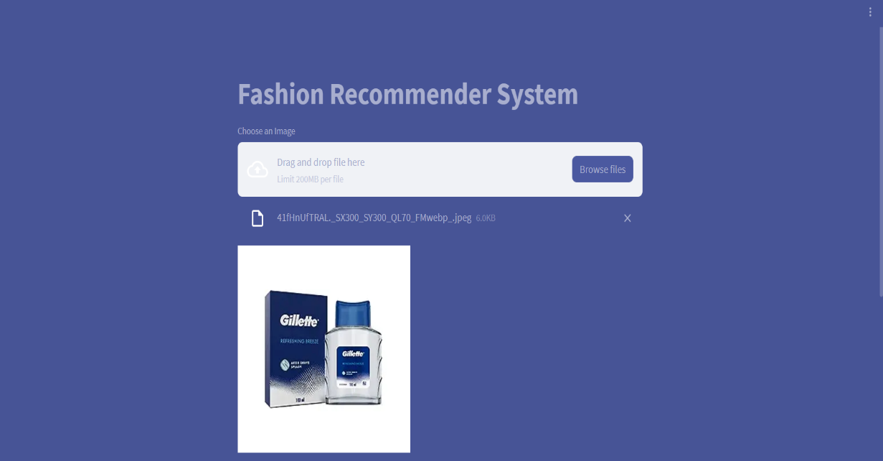
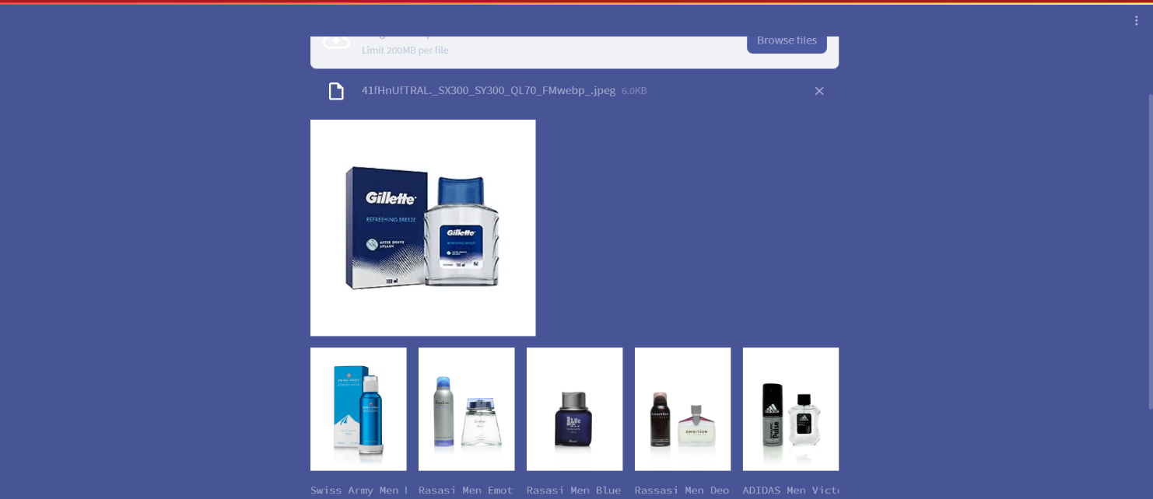
Model Deployment
Model deployment using Streamlit involves creating a web application that allows users to interact with a trained machine learning model.
We took an input image from a third-party e-commerce website and checked recommendations from our image dataset.
Model Deployment

Slide 12


